Slide 1
Lecture 3
Introduction to Deep Learning

Slide 2
Agenda
Cross Entropy Loss
Regularization
Using a Neural Network to classify points on a spiral dataset
Monitoring and tracking
K-Fold Cross Validation
Learning rate schedule

Slide 3
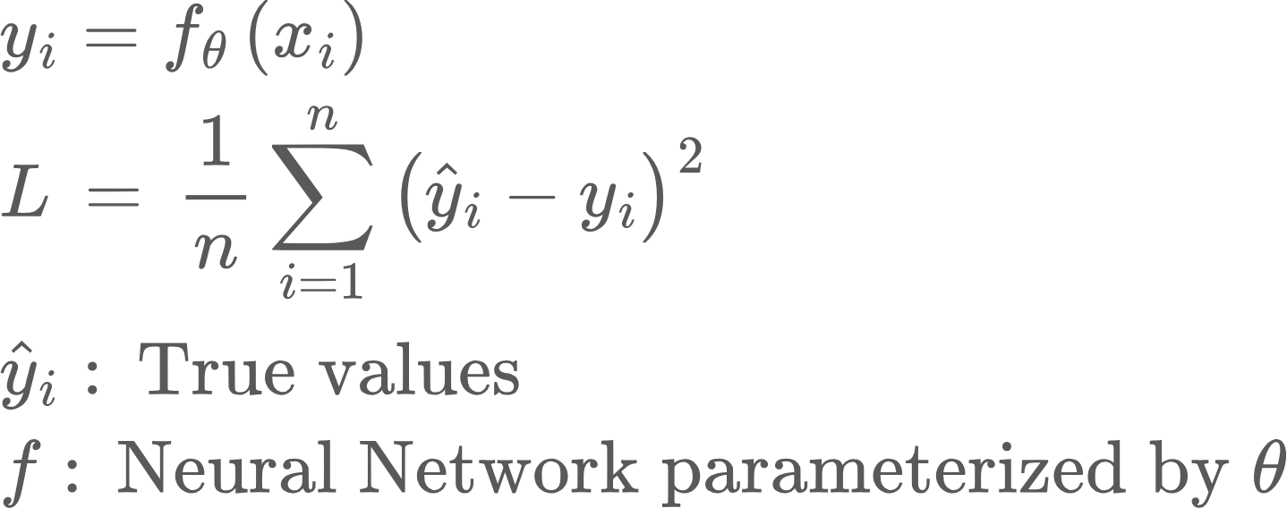
Cross Entropy Loss
In the previous slide, our network produced a real value, which could be compared to the true value using Mean Square Error loss
But what if we have a classification problem, where each data point is a class label?
In such as case, the network needs to output the probability distribution over classes, i.e., a vector, where each entry is a probability of a class.

Slide 4
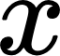
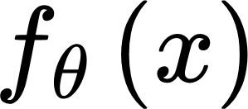
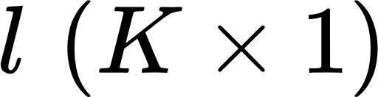
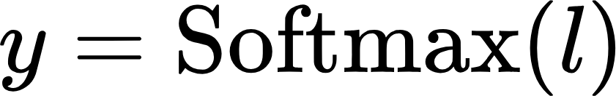
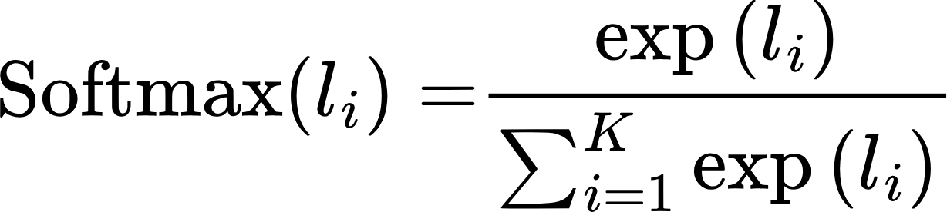
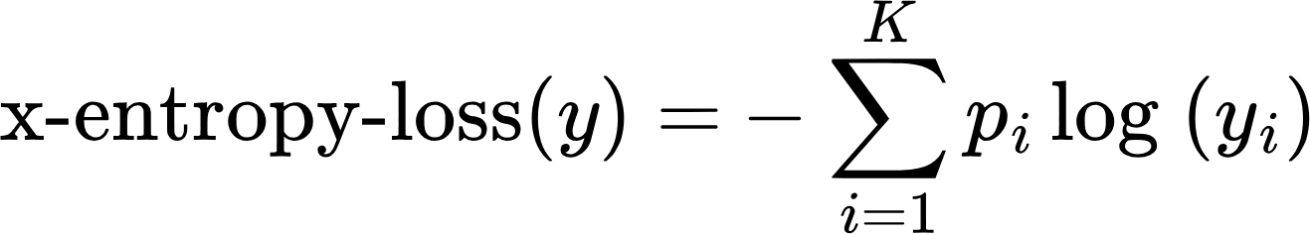
Cross Entropy Loss
First we need to convert network output into probabilities. This is done using a Softmax function. Say there are K classes
Softmax
l for logits
Now say the true probability distribution is defined by pi. Then
Usually p is a one-hot vector. It is 1 for the class x belongs to, and 0 everywhere else.

Slide 5
Cross Entropy Loss
Let’s consider a binary classification example. Here K = 2
Let’s say p_1 = 1. If the network gets it right, y_1 is close to 1, and x-entropy loss is low. Similarly if the network gets it wrong, y_1 is low, and x-entropy loss is high.
To use it within a Neural Network, we need to calculate its derivative!

Slide 6
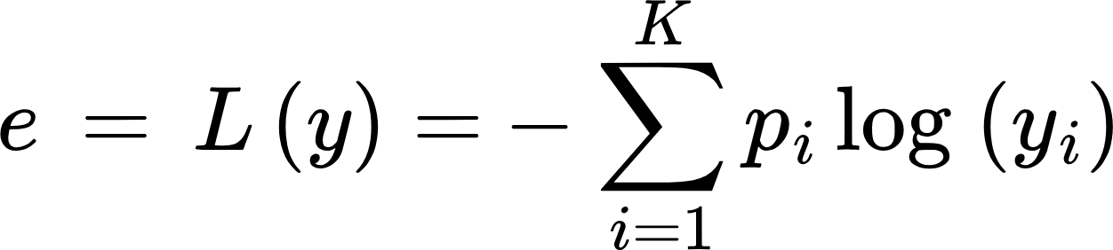
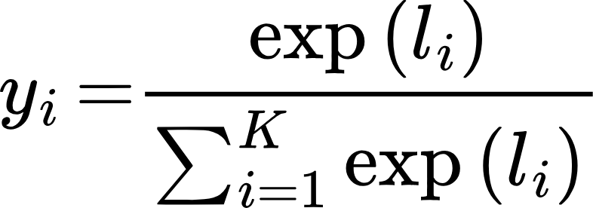
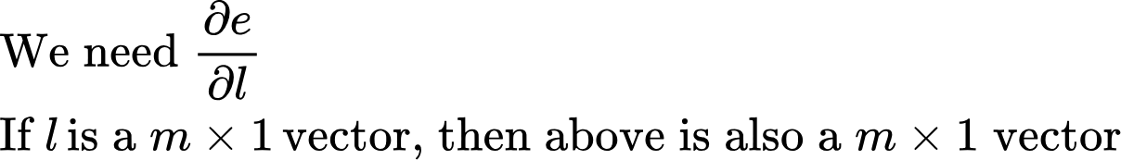
Cross Entropy Loss: Derivative
Let’s consider a binary classification example. Here K = 2
Let’s now derive the partial of e against partial of l using basic math

Slide 7
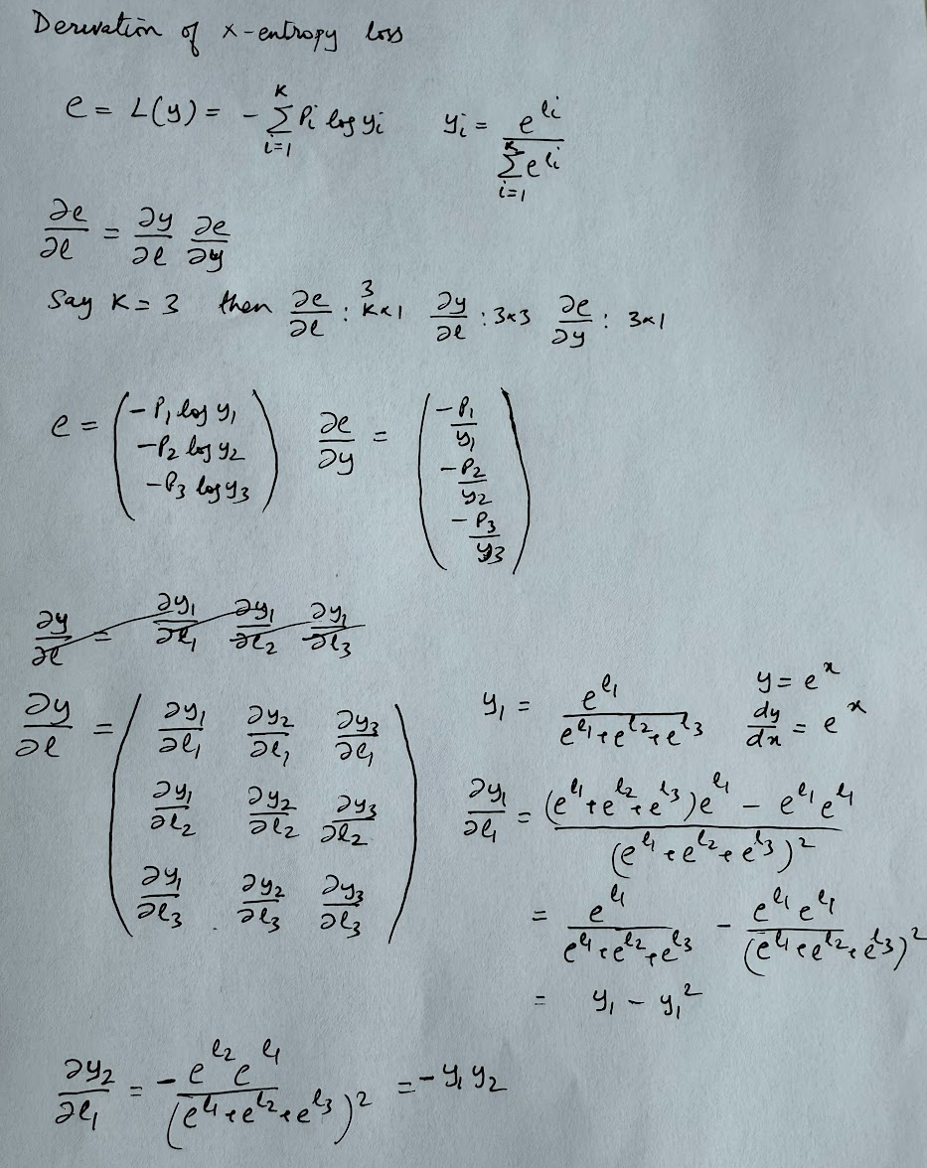
Cross Entropy Loss: Derivative

Slide 8
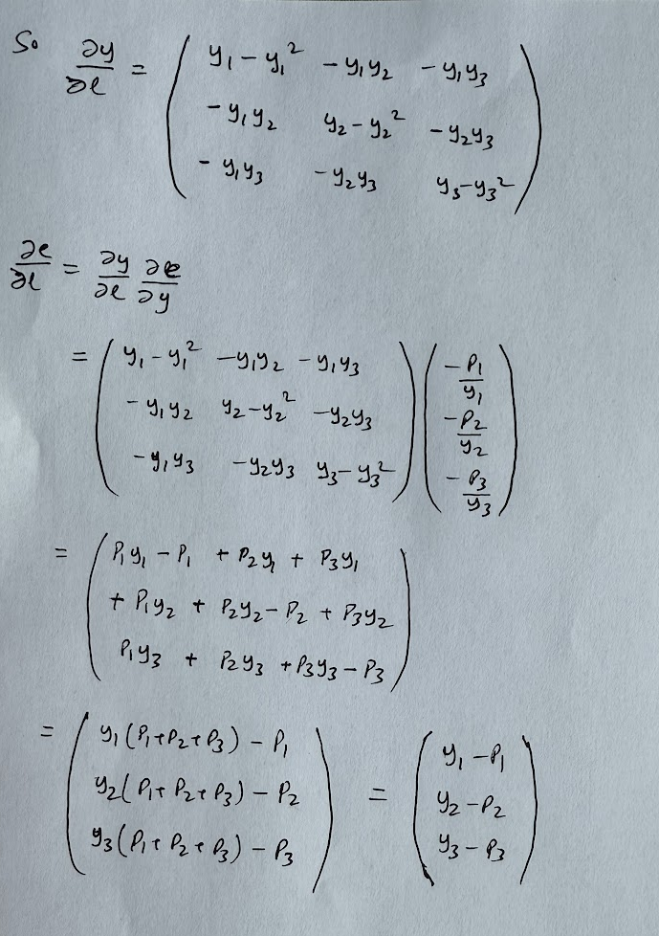
Cross Entropy Loss: Derivative

Slide 9
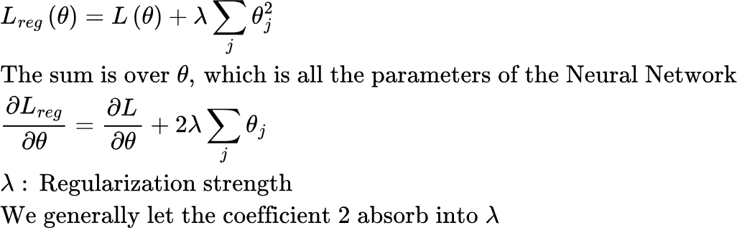
Regularization
Regularization means imposing constraints on the optimization process to meet certain desirable properties. Eg.,
It is a good idea to keep the weights of a Neural Network small.
Large weights make the model more sensitive to input noise → risk of overfitting.
Small weights encourage simpler functions, which often generalize better.
This can be accomplished by adding a weight dependent term to the loss function

Slide 10
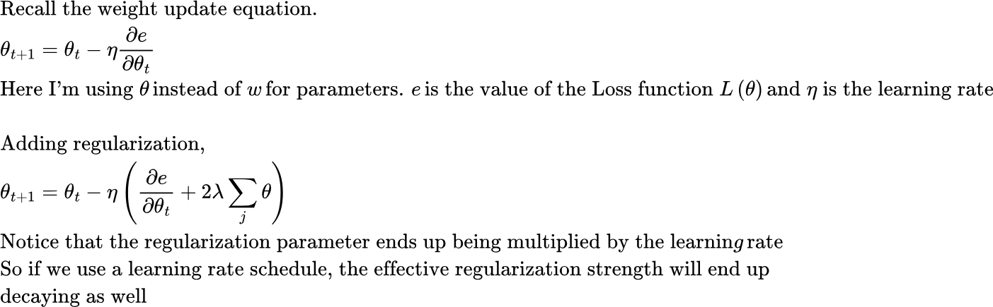
Regularization
Generally, regularization is not applied to bias parameters. This is because bias often represents a "baseline prediction" (e.g., class prior probability). Regularizing it could distort this baseline estimate.
Thinking of weights as the “slopes” of lines and biases as the “intercepts.”
Penalizing slopes keeps the line from becoming too steep (simpler model).
Penalizing intercepts just pushes the line toward the origin, which doesn’t really fight overfitting — it just shifts everything awkwardly.
Note: lambda is called “weight decay” in Pytorch.. But there is a subtlety, which we’ll discuss later..
If you are curious: Fixing Weight Decay Regularization in Adam” (Loshchilov & Hutter, 2017)

Slide 11
Regularization
Regularization means imposing constraints on the optimization process to meet certain desirable properties.
Another regularization method is Dropout, where during training, we randomly “drop” (set to zero) a fraction of neurons in a layer. Setting to zero means setting the corresponding activations to 0. The subset of neurons set to 0 is called “dropout mask”. This mask changes every training iteration.
The intuition is that Neurons can’t rely on specific other neurons being present and thus learn more independent, robust features.
Dropout used to be quite popular in older networks to prevent overfitting, but less common in latest Transformer-based networks. This is because the size of training datasets is huge, and each training sample is only seen a small number of times, making overfitting is less of a problem. See this article (search for dropout)

Slide 12
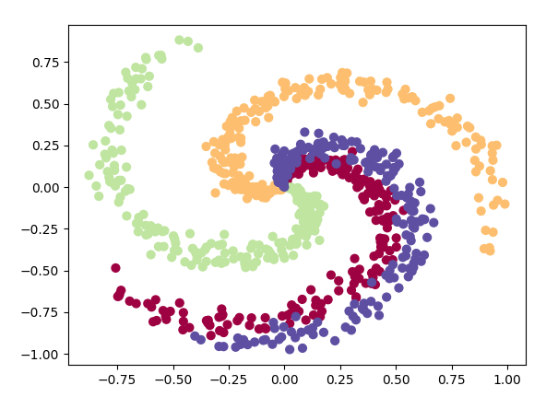
Example 2: Classifying points on a Spiral Dataset
In our first Neural Network example, we considered a regression problem, where the network was trained to predict the value of a sine function. Now we’ll consider a classification problem in 2D, where we have a set of points that lie on one of the arms of a spiral dataset. The task is to predict the label of the arm for each point.
Key differences from before:
The dimension of our input data is now 2, rather than 1
We’ll use cross-entropy loss rather than mean square error
Use of regularization
Logging metrics in Tensorboard

Slide 13
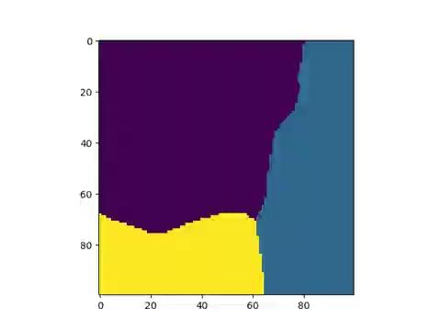

Slide 14
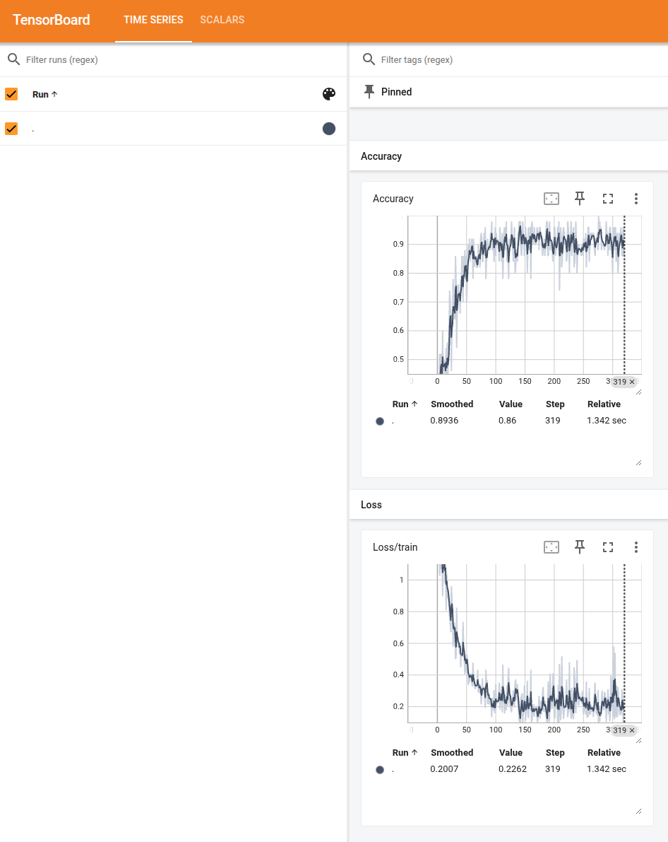
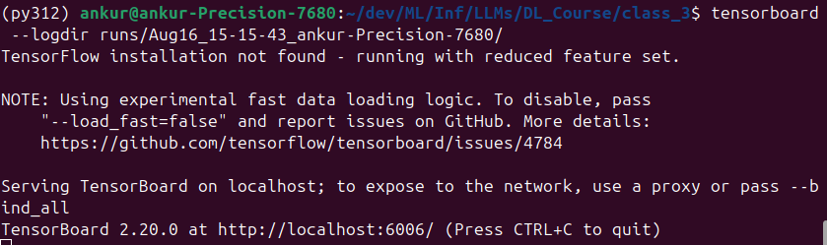
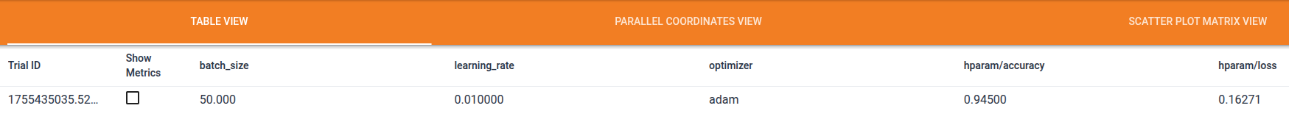
Monitoring using TensorBoard
Primary Use: Visualize training metrics and debugging info
Metrics
Pytorch Program
Logs directory
Can be local or cloud storage
UI: Can use port forwarding if Tensorboard server running remotely
Pip install tensorboard
Tensorboard Server
Can run locally or cloud-hosted
simple_nn2.py

Slide 15
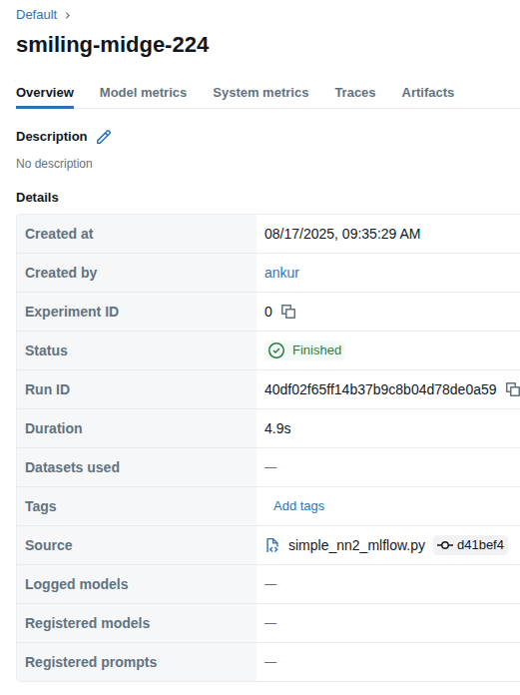
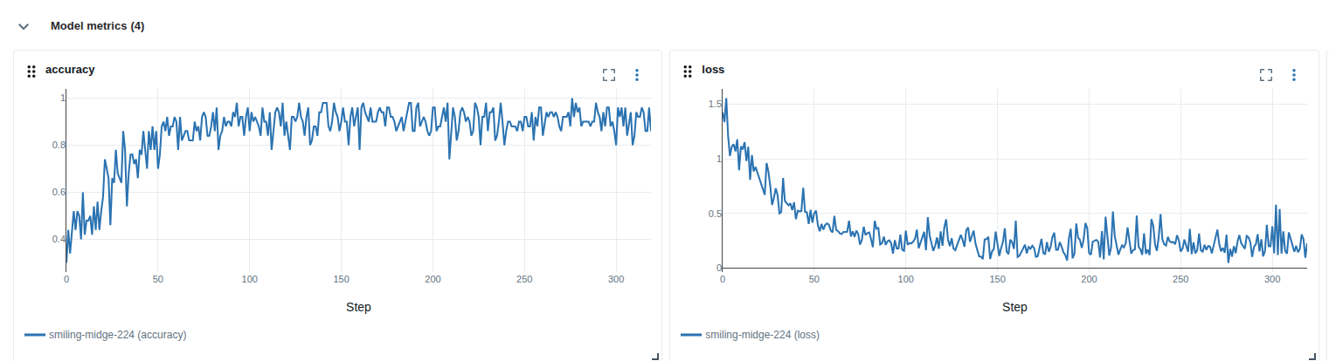
Monitoring using MLFlow
Primary Use: End-to-end ML lifecycle: track experiments, manage models, deployments
Run MLFlow server with:
backend store: Typically a database such as PostGres, MySQL, or MSSQL. For storing parameters, metrics, and tags
artifact store: local directory or cloud storage such as S3. For large artifacts such as model weights, checkpoints..
Pytorch Program
Artifact location, presigned S3 URLs..
MLFlow Server
Backend store
Metadata
Metadata Params, metrics, tags..
Artifacts
If no mlflow tracking server configured, mlflow client will write metrics to local mlruns directory
Artifact store
simple_nn2_mlflow.py

Slide 16
Monitoring using Weights and Biases
Area | Weights & Biases (W&B) | MLflow
Core goal | Experiment tracking & collaboration | End-to-end ML lifecycle (track, package, registry, serve)
Hosting | Primarily SaaS (with enterprise self-host/on-prem options) | Open source, easy to self-host (FS/DB/S3/GCS/etc.)
Experiment tracking | Excellent UI/UX, live dashboards, rich comparisons | Solid tracking; simpler UI; highly portable metadata
Hyperparam optimization | Sweeps: first-class HPO with schedulers/search | No native HPO; plug in Optuna/Ray/Tune and log to MLflow
Collaboration | Reports, tables, comments, sharing, org features | Basic comparisons; collaboration mostly via your infra
Cost/lock-in | SaaS convenience; enterprise plans; some lock-in risk via UI features | No license cost; infra cost only; minimal lock-in (files/API)
https://wandb.ai/site/

Slide 17
HW Monitoring Tools
To analyze hardware metrics such as GPU utilization, time taken by various CUDA kernels etc, there are several tools, some HW vendor specific, some offered by deep learning libraries
Pytorch profiler for determining the most expensive operators in the model. The UI is integrated with TensorBoard
NVIDIA Visual Profiler: Detailed GPU-level stats. Great for low-level GPU profiling
Intel VTune: Profiler from Intel
We’ll look at Pytorch profiler and NVIDIA Visual Profiler in detail when we discuss running Neural Networks on GPUs

Slide 18
K-Fold Cross Validation
K-Fold Cross Validation:
Shuffle & Split the dataset into K folds (e.g., K=5).
Iteration: For each of the K folds:
Use K-1 folds for training.
Use the remaining 1 fold for validation (testing).
Repeat until every fold has served as the validation set exactly once.
Aggregate results by averaging the performance metrics (accuracy, F1, RMSE, etc.).
Train
Validate
Test
Naive training loop:
For every epoch:
For all training data:
Sample data and run training loop on training data
Evaluate performance on validation data
End Training
Evaluate performance on trained model on held out test data
But what if validation subset contains important data we want training to see?
Example:
Dataset → split into folds: [F1, F2, F3]
Run 1: Train = [F2+F3], Test = [F1]
Run 2: Train = [F1+F3], Test = [F2]
Run 3: Train = [F1+F2], Test = [F3]
Final performance = average of all 5 test results.
Generally not used during large Neural Network training..

Slide 19
Learning Rate Schedule

Slide 20
Accuracy can be misleading, specially when dataset is unbalanced
Declare H0
Declare H1
Is H0
Recall is the fraction of events where we correctly declared h0, out of all instances that are h0
Is H1
precision is the fraction of events where we correctly declared h0, out of all instances where we declared h0

